Slide 1

Augmented Reality For Marketing
TU7FA
Faculty of Computer and Information Science Ain Shams University‎‏
Supervisors:
Dr/ Mariam El-Berry
TA/ Doaa Ezzat
Department :Scientific Computing

Slide 2

OUR TEAM :
Mohamed Maher Osman
Mohamed Samir Mohamed
Ahmed AbdElaty Younis
Heba Massoud Awad
Hadeer Sabry Abd Elsalam

Slide 3

Agenda:
Introduction:
Problem Definition
Motivation
Objectives
Survey
Techniques
Important Results
System Architecture
Our Work
Tu7fa Demo
Conclusion & Future work
Tools

Slide 4
PROBLEM DEFINITION :
Augmented Reality
AR is “an enhanced version of reality created by the use of technology to overlay digital information on an image of something being viewed through a device (such as a smartphone camera).”

Slide 5

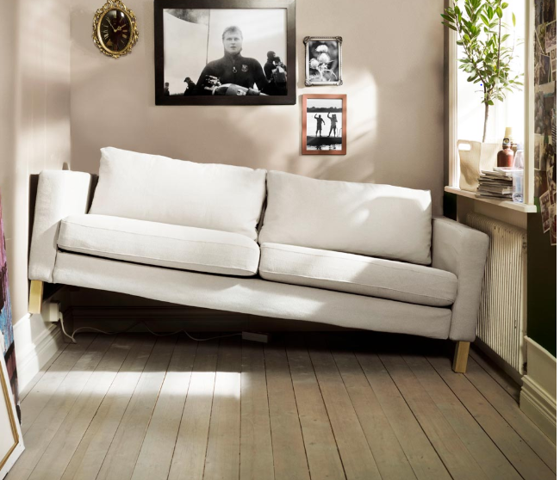
MOTIVATION:
Shopping Time | Efforts
Suitable | take Overview

Slide 6
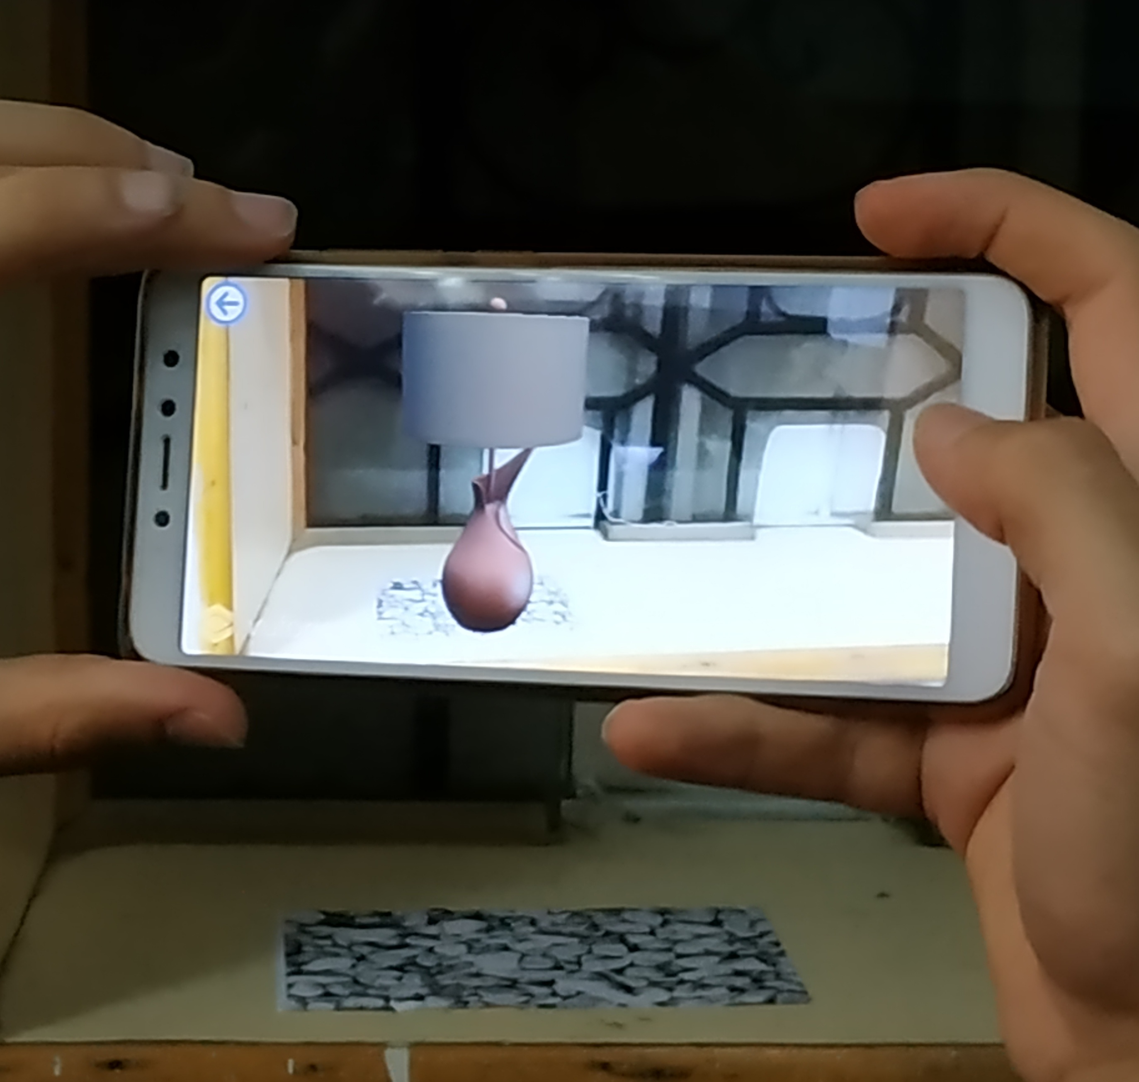
OBJECTIVES:
Developing An Offline Application That Using Augmented Reality In Marketing That Enable User To Visualize How Virtual Accessories Would Look In Given Space
Easy And Simple To Use

Slide 7
Survey:
Types Of Augmented Reality Applications
Marker-based applications
-Based on Image target (Marker )
-The majority of AR apps are marker-based.
*TU7FA AR APPLICATION
Location-based applications
Work without markers (Marker less)
Pokemon Go.

Slide 8
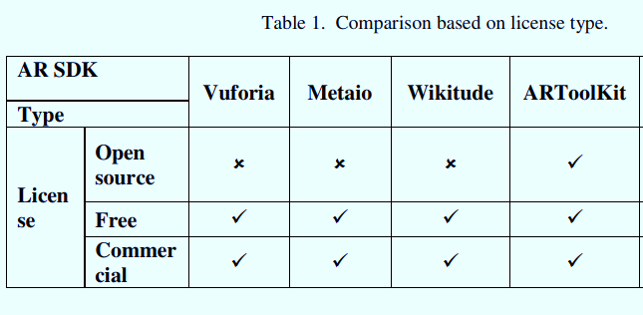
COMPARISON OF AUGMENTED REALITY SDK’S

Slide 9
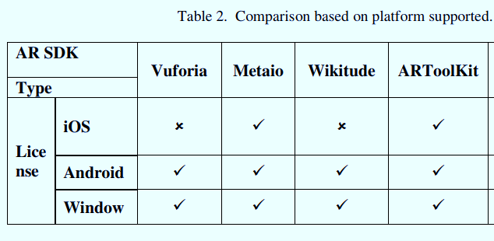
Cont.

Slide 10
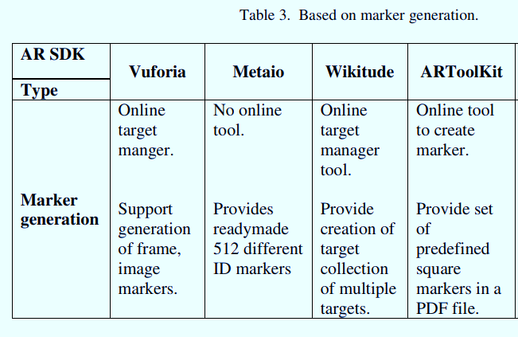
Cont.

Slide 11
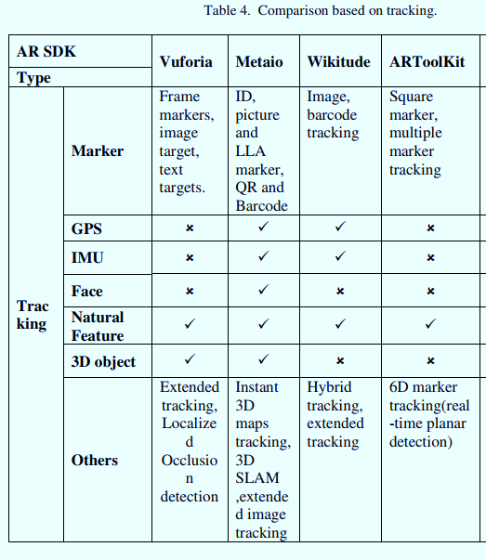
Cont.

Slide 12
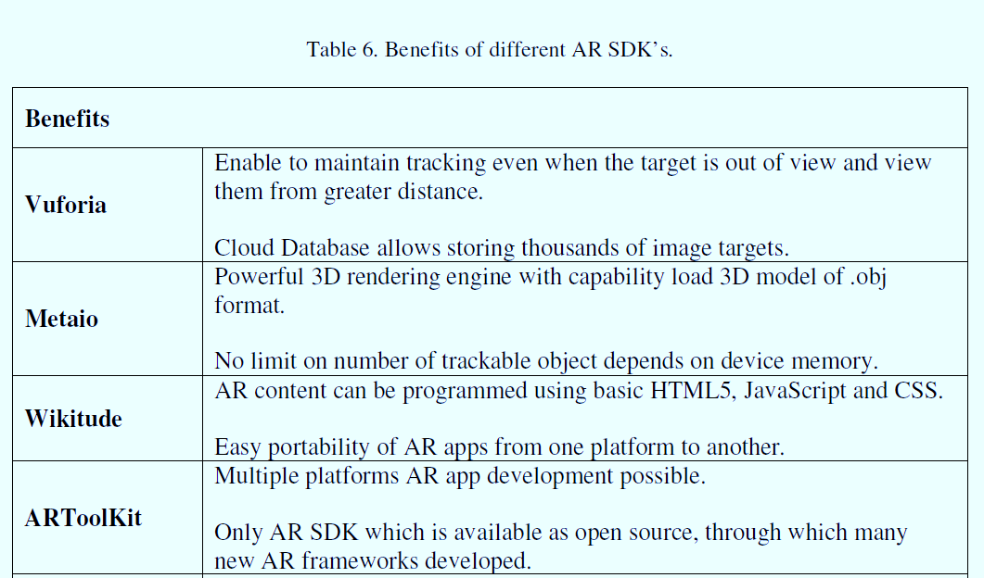
Cont.

Slide 13
Techniques
ARToolKit
ARCore
Vuforia Ground Plane
IS Apple’s augmented reality (AR) development platform for iOS mobile
ARKit uses the iPhone’s
Google’s answer to Apple’s ARKit was ARCore - the AR framework for Android devices
Enables you to place content on horizontal surfaces in the environment like tables and floors.

Slide 14
Vuforia Augmented Reality SDK
Important Results:
Vuforia Engine is the most widely used platform for AR development
It uses computer vision technology to recognize and track Image Targets
Provide support for advanced computer vision functionality to Android and IOS
Vuforia Engine API includes C# APIs for Unity, C++ APIs for IOS and Universal Windows Platform (UWP) and Java for Android.
Vuforia is able to recognize and track targets by analyzing the contrast based features of the target
Improving the performance of a target by improving the visibility of these features through adjustments to the target's design

Slide 15
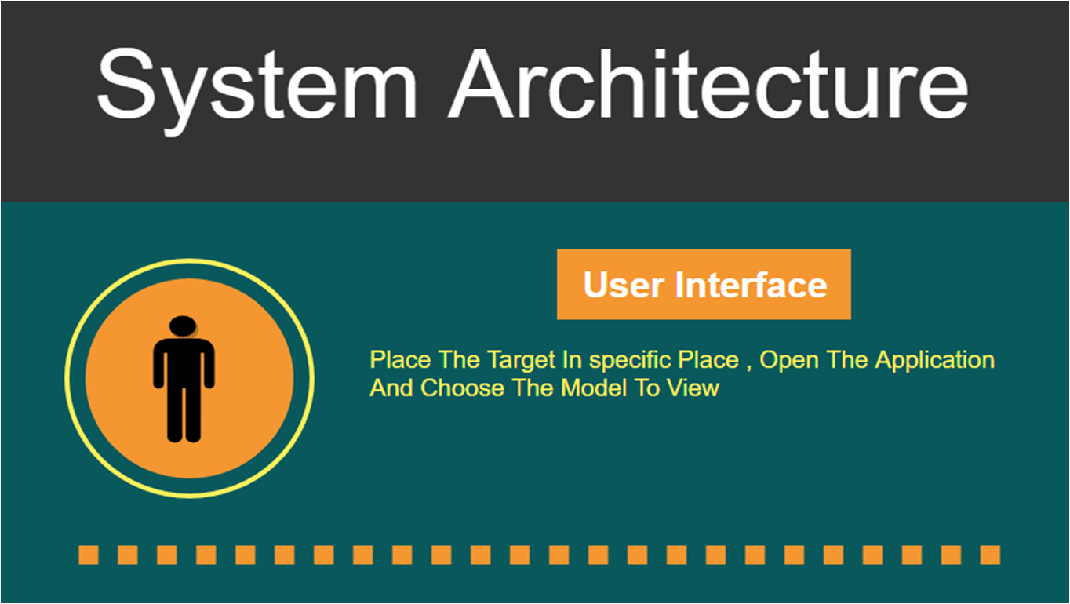
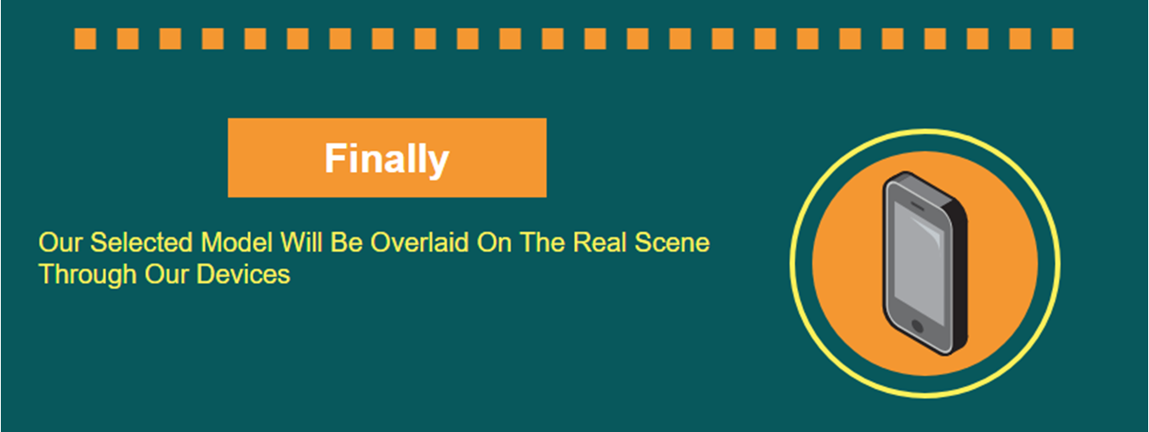
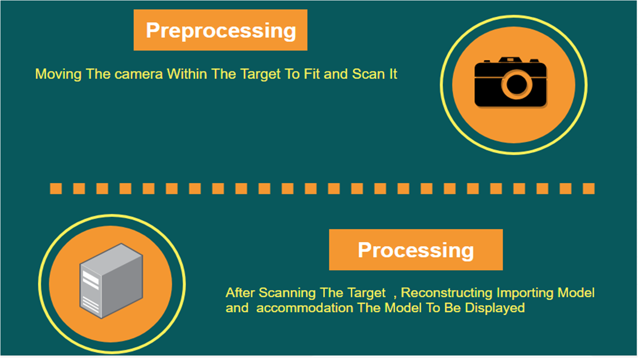
SYSTEM ARCHITECTURE

Slide 16

OUR WORK
VUFORIA (Marker Based)
IMAGE TARGET
Camera focus, modes
Lighting conditions, Target size
Viewing angle, Rich in detail, Good contrast

Slide 17
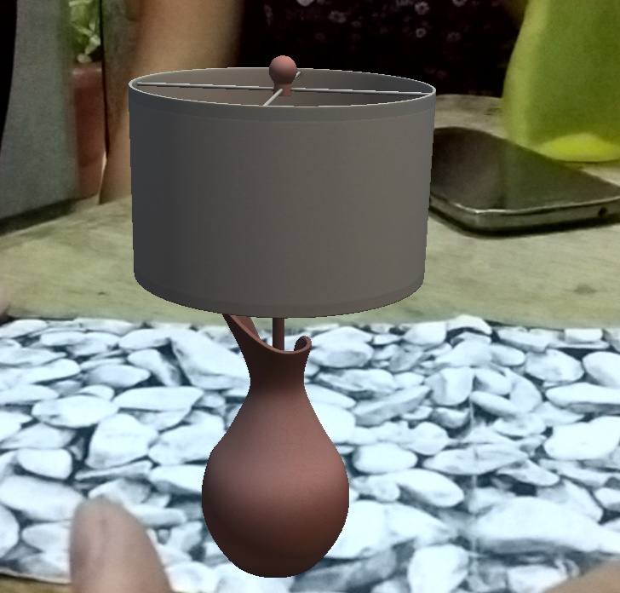
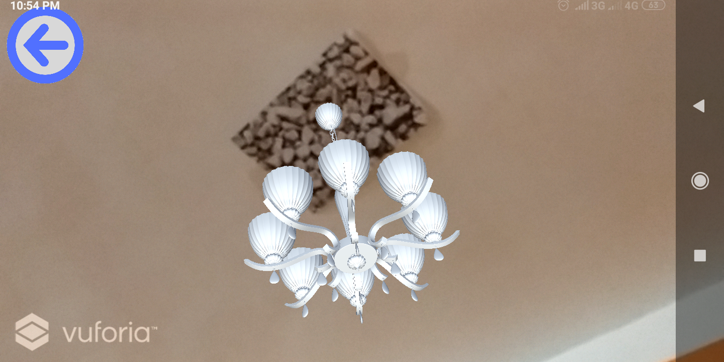
CONT.
Models

Slide 18
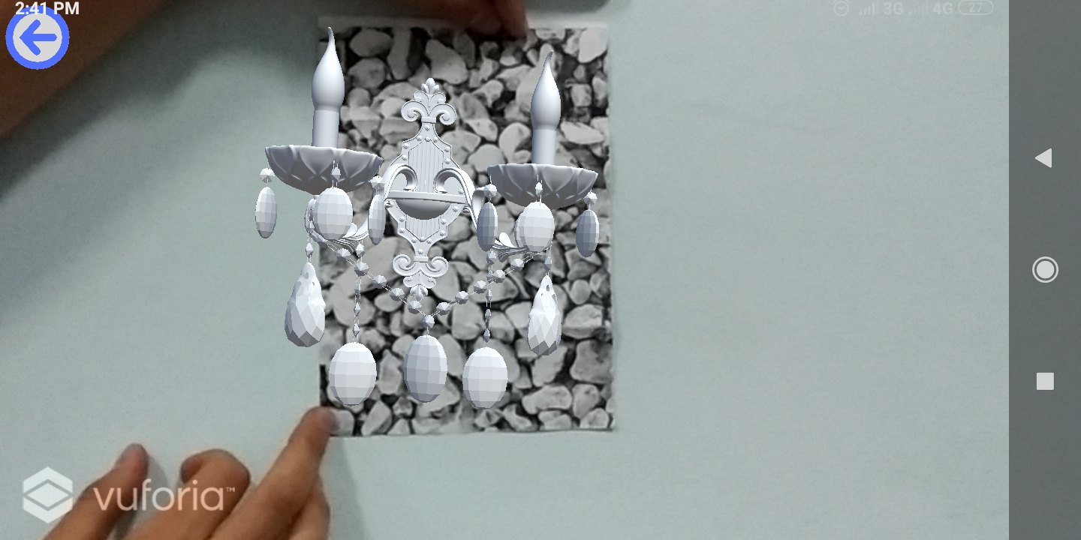
CONT.
Models

Slide 19

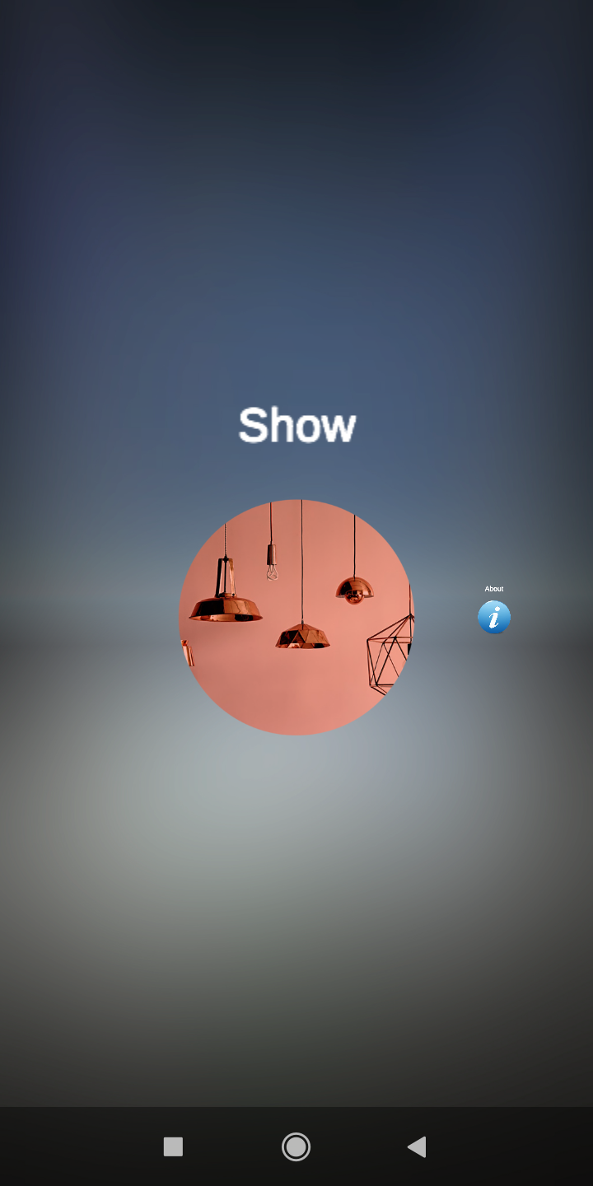
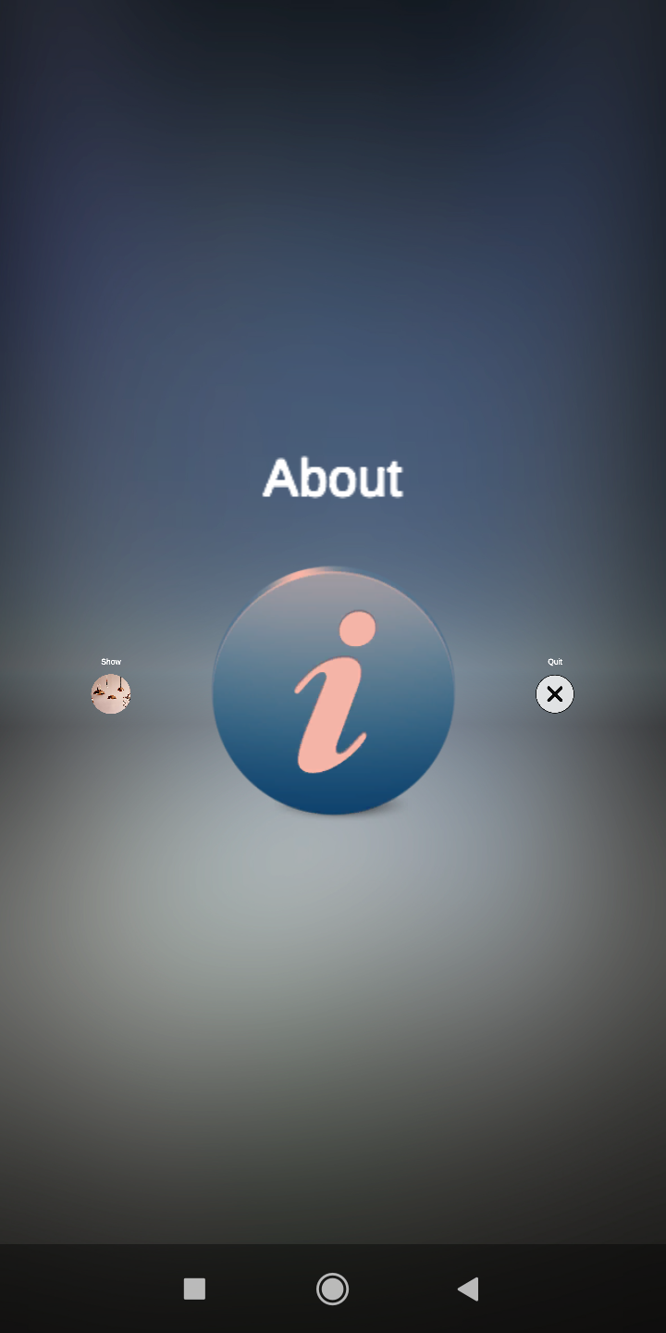
TU7FA AR APP

Slide 20
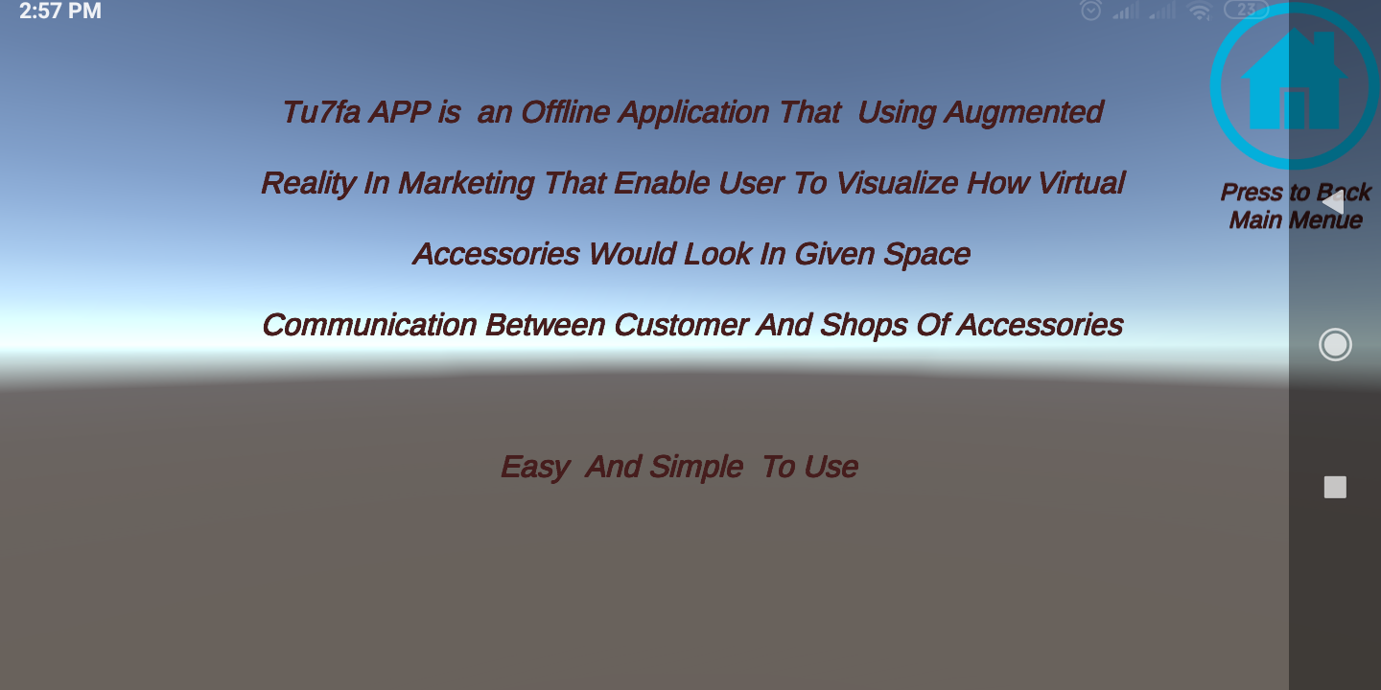
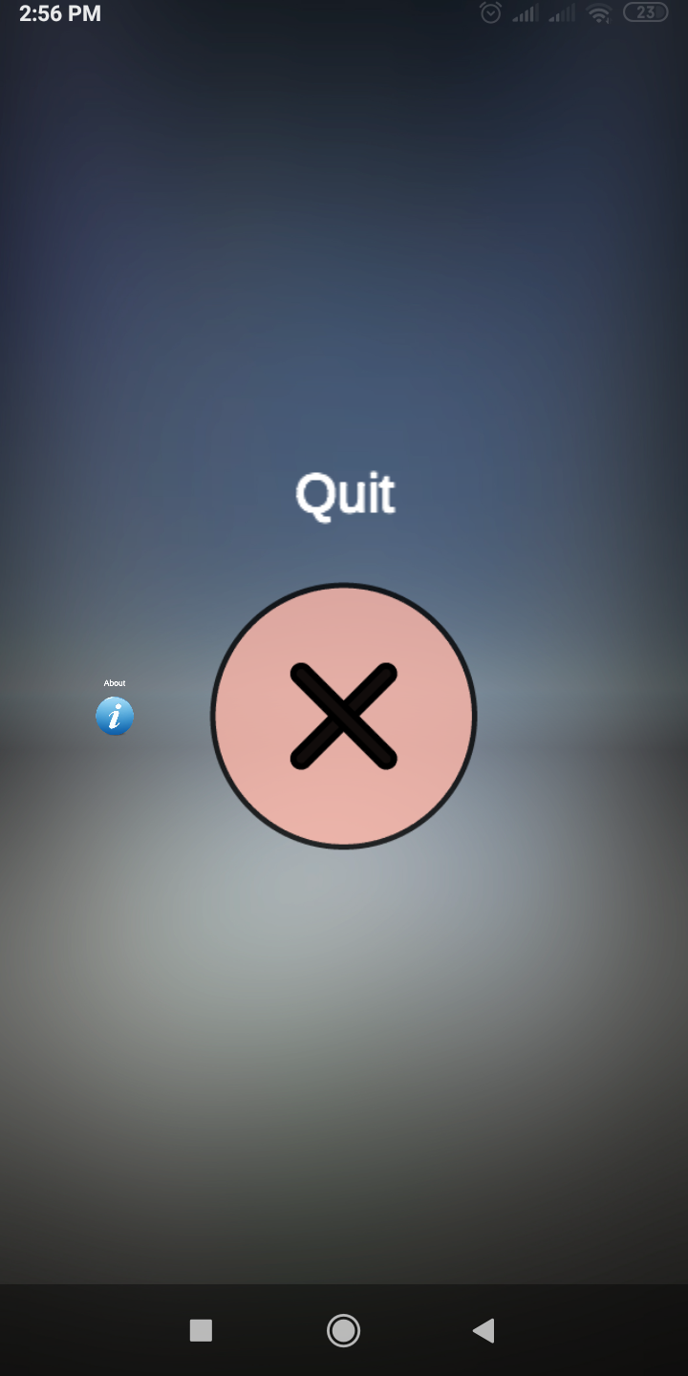
CONT.

Slide 21
Tu7fa DEMO

Slide 22
Conclusion
Tu7fa Application is an Offline Application That Using Augmented Reality In Marketing That Enable User To Visualize How Virtual Accessories Would Look In Given Space
user open application and press show button then go to object scene , user choose Accessory and press on it , put image target in given space then camera will
open and detect features from image target and show accessory
Advantages:-
Cover many versions of Android
Easy And Simple To Use
Communication Between Customer And Shops Of Accessories
Save Shopping Time and Efforts
Marker-based applications
Disadvantages:-
Using Image Target have properties:-
(Camera focus modes ,Lighting conditions, Target size, Viewing angle, Rich in detail and Good contrast).

Slide 23
Future Work
In next step we will
Dealing with many companies of accessories and take model or photos from each company to make category for each company
Make cloud server to upload accessories for each company which have different colors ,kinds and price and we wish this idea will help user to save time ,Efforts and choose appropriate accessory and put it in given space Convince them before buy
We will intended to expand the project to cover many platforms such as Android ,IOS and window
Finally this application is considered Link among users and companies

Slide 24



Tools
Unity | Vuforia | Visual Studio

Slide 25
THANK YOU!

